Slide 1
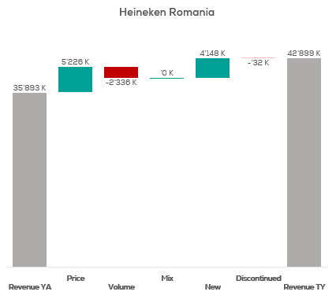
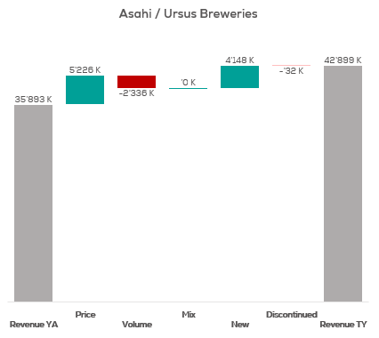
Revenue by Price vs. Volume vs. Mix analysis (Replace with So What)
Revenue by Price vs. Volume vs. Mix analysis | Heineken Romania vs. Asahi | Category | National | P12M
DATA SOURCE: Trade Panel/Retailer Data | Ending Apr 2024

Slide 2
Revenue by Price vs. Volume vs. Mix analysis (Replace with So What)
Revenue by Price vs. Volume vs. Mix analysis | Heineken Romania vs. Asahi | Category | National | P12M
DATA SOURCE: Trade Panel/Retailer Data | Ending Apr 2024

Slide 3
Revenue by Price vs. Volume vs. Mix analysis (Replace with So What)
Revenue by Price vs. Volume vs. Mix analysis | Heineken Romania vs. Asahi | Category | National | P12M
DATA SOURCE: Trade Panel/Retailer Data | Ending Apr 2024

Slide 4
Revenue by Price vs. Volume vs. Mix analysis (Replace with So What)
Revenue by Price vs. Volume vs. Mix analysis | Heineken Romania vs. Asahi | Category | National | P12M
DATA SOURCE: Trade Panel/Retailer Data | Ending Apr 2024

Slide 5
Revenue by Price vs. Volume vs. Mix analysis (Replace with So What)
Revenue by Price vs. Volume vs. Mix analysis | Heineken Romania vs. Asahi | Category | National | P12M
DATA SOURCE: Trade Panel/Retailer Data | Ending Apr 2024

Slide 6
Revenue by Price vs. Volume vs. Mix analysis (Replace with So What)
Revenue by Price vs. Volume vs. Mix analysis | Heineken Romania vs. Asahi | Category | National | P12M
DATA SOURCE: Trade Panel/Retailer Data | Ending Apr 2024

Slide 7
Revenue by Price vs. Volume vs. Mix analysis (Replace with So What)
Revenue by Price vs. Volume vs. Mix analysis | Heineken Romania vs. Asahi | Category | National | P12M
DATA SOURCE: Trade Panel/Retailer Data | Ending Apr 2024

Slide 8
Revenue by Price vs. Volume vs. Mix analysis (Replace with So What)
Revenue by Price vs. Volume vs. Mix analysis | Heineken Romania vs. Asahi | Category | National | P12M
DATA SOURCE: Trade Panel/Retailer Data | Ending Apr 2024

Slide 9
Revenue by Price vs. Volume vs. Mix analysis (Replace with So What)
Revenue by Price vs. Volume vs. Mix analysis | Heineken Romania vs. Asahi | Category | National | P12M
DATA SOURCE: Trade Panel/Retailer Data | Ending Apr 2024

Slide 10
Revenue by Price vs. Volume vs. Mix analysis (Replace with So What)
Revenue by Price vs. Volume vs. Mix analysis | Heineken Romania vs. Asahi | Category | National | P12M
DATA SOURCE: Trade Panel/Retailer Data | Ending Apr 2024

Slide 11
Revenue by Price vs. Volume vs. Mix analysis (Replace with So What)
Revenue by Price vs. Volume vs. Mix analysis | Heineken Romania vs. Asahi | Category | National | P12M
DATA SOURCE: Trade Panel/Retailer Data | Ending Apr 2024

Slide 12
Revenue by Price vs. Volume vs. Mix analysis (Replace with So What)
Revenue by Price vs. Volume vs. Mix analysis | Heineken Romania vs. Asahi | Category | National | P12M
DATA SOURCE: Trade Panel/Retailer Data | Ending Apr 2024

Slide 13
Revenue by Price vs. Volume vs. Mix analysis (Replace with So What)
Revenue by Price vs. Volume vs. Mix analysis | Heineken Romania vs. Asahi | Category | National | P12M
DATA SOURCE: Trade Panel/Retailer Data | Ending Apr 2024

Slide 14
Revenue by Price vs. Volume vs. Mix analysis (Replace with So What)
Revenue by Price vs. Volume vs. Mix analysis | Heineken Romania vs. Asahi | Category | National | P12M
DATA SOURCE: Trade Panel/Retailer Data | Ending Apr 2024

Slide 15
Revenue by Price vs. Volume vs. Mix analysis (Replace with So What)
Revenue by Price vs. Volume vs. Mix analysis | Heineken Romania vs. Asahi | Category | National | P12M
DATA SOURCE: Trade Panel/Retailer Data | Ending Apr 2024

Slide 16
Revenue by Price vs. Volume vs. Mix analysis (Replace with So What)
Revenue by Price vs. Volume vs. Mix analysis | Heineken Romania vs. Asahi | Category | National | P12M
DATA SOURCE: Trade Panel/Retailer Data | Ending Apr 2024

Slide 17
Revenue by Price vs. Volume vs. Mix analysis (Replace with So What)
Revenue by Price vs. Volume vs. Mix analysis | Heineken Romania vs. Asahi | Category | National | P12M
DATA SOURCE: Trade Panel/Retailer Data | Ending Apr 2024

Slide 18
Revenue by Price vs. Volume vs. Mix analysis (Replace with So What)
Revenue by Price vs. Volume vs. Mix analysis | Heineken Romania vs. Asahi | Category | National | P12M
DATA SOURCE: Trade Panel/Retailer Data | Ending Apr 2024

Slide 19
Revenue by Price vs. Volume vs. Mix analysis (Replace with So What)
Revenue by Price vs. Volume vs. Mix analysis | Heineken Romania vs. Asahi | Category | National | P12M
DATA SOURCE: Trade Panel/Retailer Data | Ending Apr 2024

Slide 20
Revenue by Price vs. Volume vs. Mix analysis (Replace with So What)
Revenue by Price vs. Volume vs. Mix analysis | Heineken Romania vs. Asahi | Category | National | P12M
DATA SOURCE: Trade Panel/Retailer Data | Ending Apr 2024

Slide 21
Revenue by Price vs. Volume vs. Mix analysis (Replace with So What)
Revenue by Price vs. Volume vs. Mix analysis | Heineken Romania vs. Asahi | Category | National | P12M
DATA SOURCE: Trade Panel/Retailer Data | Ending Apr 2024

Slide 22
Revenue by Price vs. Volume vs. Mix analysis (Replace with So What)
Revenue by Price vs. Volume vs. Mix analysis | Heineken Romania vs. Asahi | Category | National | P12M
DATA SOURCE: Trade Panel/Retailer Data | Ending Apr 2024

Slide 23
Revenue by Price vs. Volume vs. Mix analysis (Replace with So What)
Revenue by Price vs. Volume vs. Mix analysis | Heineken Romania vs. Asahi | Category | National | P12M
DATA SOURCE: Trade Panel/Retailer Data | Ending Apr 2024

Slide 24
Revenue by Price vs. Volume vs. Mix analysis (Replace with So What)
Revenue by Price vs. Volume vs. Mix analysis | Heineken Romania vs. Asahi | Category | National | P12M
DATA SOURCE: Trade Panel/Retailer Data | Ending Apr 2024

Slide 25
Revenue by Price vs. Volume vs. Mix analysis (Replace with So What)
Revenue by Price vs. Volume vs. Mix analysis | Heineken Romania vs. Asahi | Category | National | P12M
DATA SOURCE: Trade Panel/Retailer Data | Ending Apr 2024

Slide 26
Revenue by Price vs. Volume vs. Mix analysis (Replace with So What)
Revenue by Price vs. Volume vs. Mix analysis | Heineken Romania vs. Asahi | Category | National | P12M
DATA SOURCE: Trade Panel/Retailer Data | Ending Apr 2024

Slide 27
Revenue by Price vs. Volume vs. Mix analysis (Replace with So What)
Revenue by Price vs. Volume vs. Mix analysis | Heineken Romania vs. Asahi | Category | National | P12M
DATA SOURCE: Trade Panel/Retailer Data | Ending Apr 2024

Slide 28
Revenue by Price vs. Volume vs. Mix analysis (Replace with So What)
Revenue by Price vs. Volume vs. Mix analysis | Heineken Romania vs. Asahi | Category | National | P12M
DATA SOURCE: Trade Panel/Retailer Data | Ending Apr 2024

